Slide 1

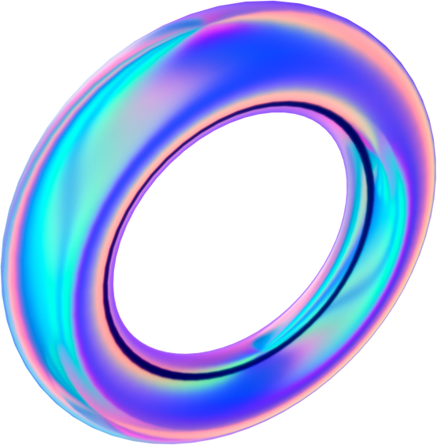

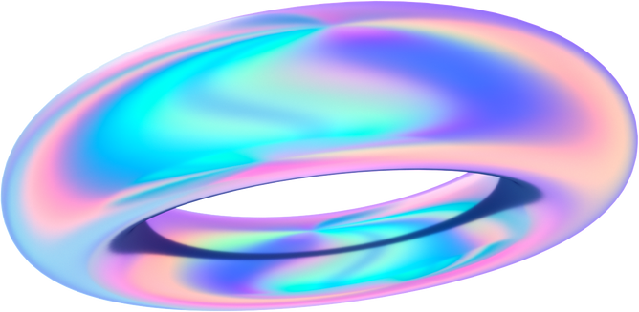

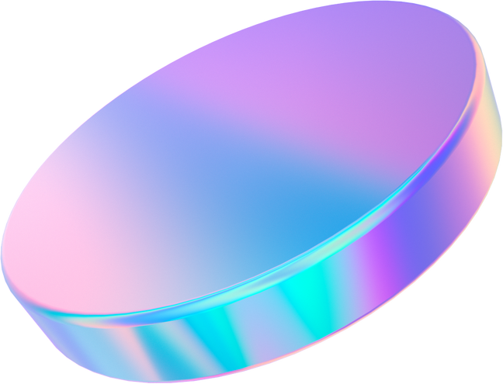
MUSIC RECOMMENDATION SYSTEM

Slide 2
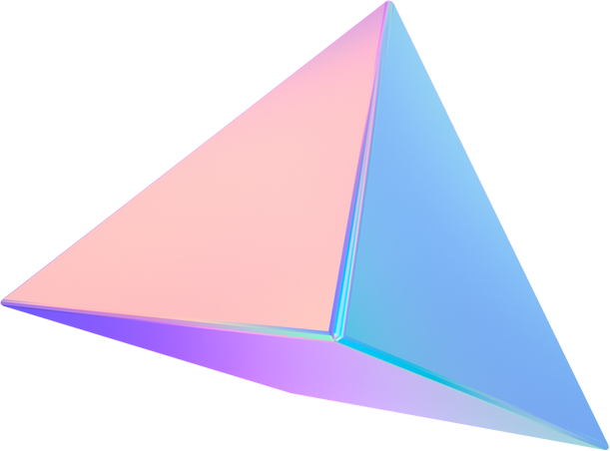
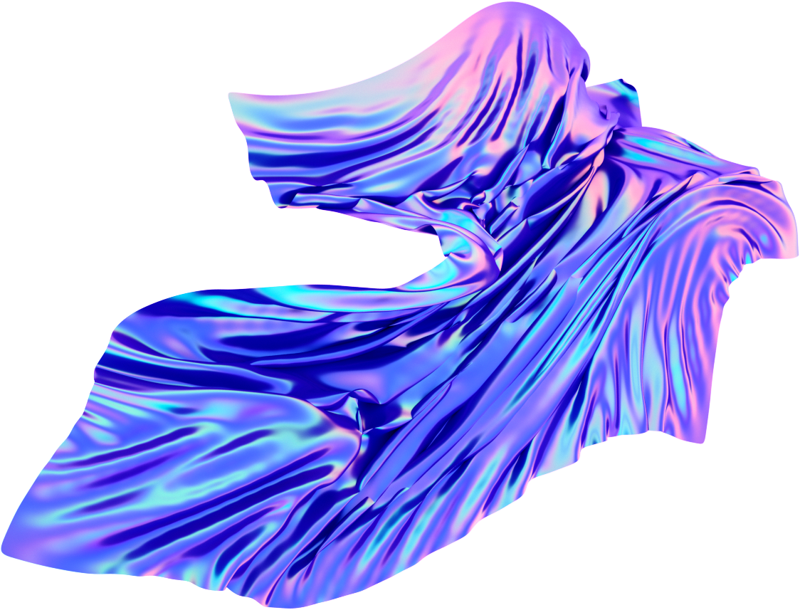
About Us
A Real-Time Music Recommendation System Using Hybrid Data Structures is a system that recommends music based on the user's emotional state. The system combines data from user preferences and emotions to generate real-time music recommendations. The system is aimed at providing an enhanced music listening experience for users.
The

Slide 3
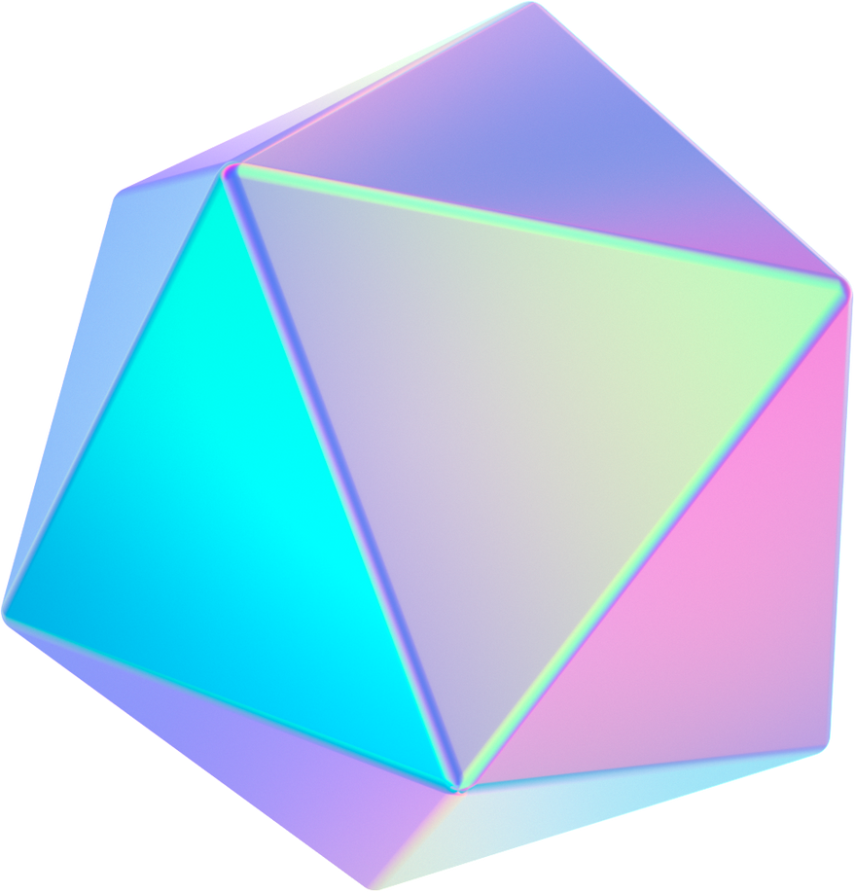


Emotion Recognition
Emotion Recognition is a key component of the system. The system uses machine learning algorithms to recognize the user's emotional state based on their facial expressions. The system then matches the user's emotional state with suitable music genres and recommends songs that match the user's mood.
The modules used are: mediapipe,cv2,keras,tensorflow,numpy,webbrowser

Slide 4
Hybrid Data Structures
Hybrid Data Structures are used to improve the performance.The hybrid data structure used our project is a combination of a dictionary and a list.
This hybrid structure enables efficient retrieval of recommendations based on emotions and maintains order within each emotion's recommendations.
The use of hybrid data structures improves the speed and accuracy of music recommendations.
The data structures used in the Spotify playlist recommender is data frame and dictionary inside a list

Slide 5


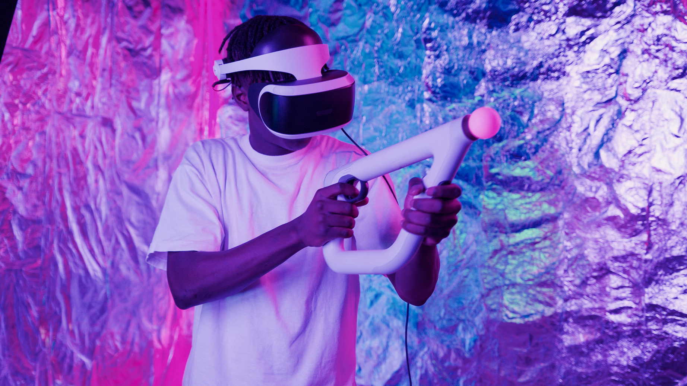
Team
Parthiv Chandran
Nirupam Abhijith

Slide 6
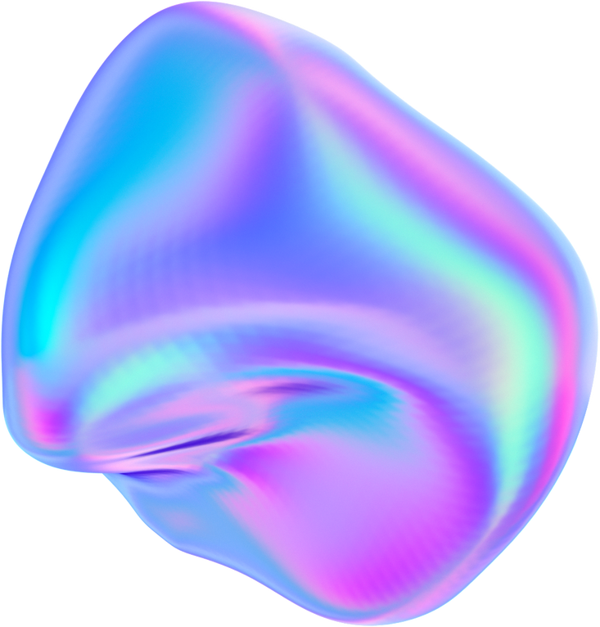

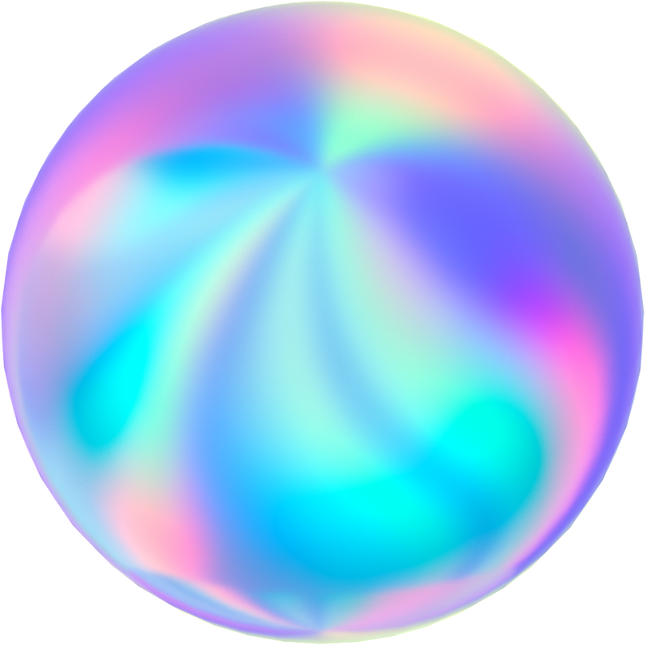
Products
Music Recommendation
based on real time emotion
Spotify playlist recommendation

Slide 7
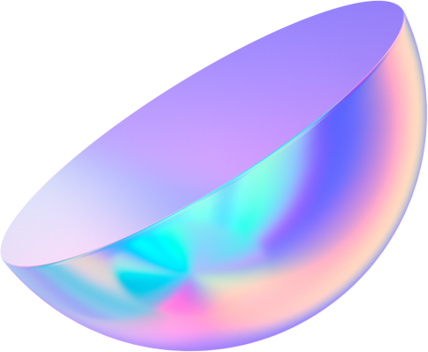
Real-Time Recommendations
Real-Time Recommendations are a core feature of the system. The system continuously updates the user's emotional state and recommends music in real-time. This ensures that the music recommendations are always relevant and match the user's current mood.

Slide 8
Benefits
Benefits of the system include enhanced music listening experience, improved emotional well-being, and increased productivity. The system can also be integrated with other applications such as fitness and meditation apps to provide a holistic experience for users. The system can be used by individuals, businesses, and organizations to improve the well-being of their users.

Slide 9

Thank You

